Slide 1
ML and Neural Networks for Sentiment Analysis
MENTOR: Drushti Apoorva Gopikrishnan
TEAM: Anandita Dhasmana, Kanishka Joshi, Kritik Mathur, Subrito Haldar

Slide 2
Problem Statement
Motivation
To employ and compare different Ml and NN techniques for hindi song lyrics and make a robust system that gives substantially accurate results.
Extracting the emotion of a song has an important application in auto playlist generation, song recommendation etc.
Not a lot of work has been done for Hindi songs.

Slide 3
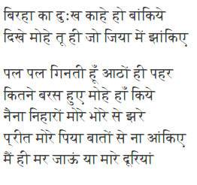
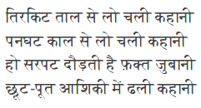
Challenges
No fixed structure to a sentence
Extensive use of metaphors
A song doesn’t necessarily have just one emotion

Slide 4
Dataset
Two sets of lyrics:
A collection of 1055 hindi songs lyrics in Devanagari script
A collection of 2553 hindi songs lyrics in Roman script

Slide 5
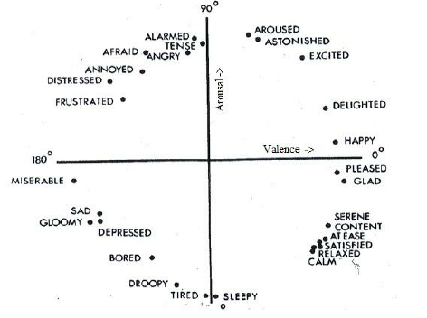
Approach
Taxonomies experimented with:
2-class taxonomy (positive / negative)
4-class taxonomy
class_E (Excited, Astonished, Delighted...)
class _A (Angry, Alert, Afraid, Annoyed...)
class_C (Calm, Relaxed, Satisfied…)
class_D (Depressed, Sad, Gloomy…)

Slide 6
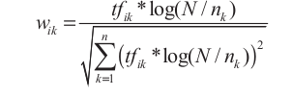
Approach (contd..)
Features experimented with:
Bag of Words
Tf-idf

Slide 7
Bag of Words
2-class | fvalue | Accuracy
k-NN (n_neighbours = 5) | 0.62 | 62.86
Gaussian NB | 0.75 | 79.05
Multinomial NB | 0.73 | 72.38
SVM | 0.68 | 78.10
Multi-Layer Perceptron | 0.79 | 80.00
4-class | fvalue | Accuracy
k-NN (n_neighbours = 5) | 0.28 | 36.89
Gaussian NB | 0.58 | 58.25
Multinomial NB | 0.60 | 60.78
SVM | 0.32 | 49.02
Multi-Layer Perceptron | 0.55 | 57.28

Slide 8
TFIDF
TFIDF
2-class | fvalue | Accuracy
k-NN (n_neighbours = 5) | 0.74 | 75.24
Gaussian NB | 0.75 | 77.36
Multinomial NB | 0.72 | 80.19
SVM | 0.67 | 77.14
Multi-Layer Perceptron | 0.81 | 80.95
4-class | fvalue | Accuracy
k-NN (n_neighbours = 5) | 0.50 | 49.51
Gaussian NB | 0.55 | 57.84
Multinomial NB | 0.56 | 60.78
SVM | 0.31 | 47.57
Multi-Layer Perceptron | 0.50 | 54.37

Slide 9
Conclusion
Future Work
Multinomial Naive Bayes performs the best with Bag of Words (Accuracy 60.78%, F1 Score 0.60)
Multinomial Naive Bayes performs the best with TFIDF (Accuracy 60.78%, F1 Score 0.56)
Transliterate Roman data to Devanagari and make a larger dataset
Use SentiWordNet for Hindi to get better results
Consider modifiers to emotion words (कुछ, बहुत, थोड़ा etc.)

